Slide 1
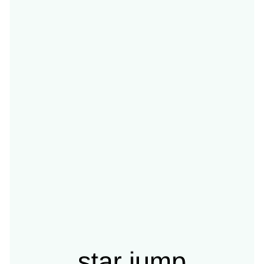
Unit 1: Computational Thinking and Programming
1.3 Sub-routines
Write it once. Use it many times.
Notes:
Welcome. Today we learn how programmers avoid repeating themselves by using sub-routines, and how variables work inside programs.

Slide 2
We are going to…
1.3 Sub-routines
learn that a sub-routine can be used multiple times in an algorithm
understand how a sub-routine can be used across different algorithms
understand how to create algorithms with more than one variable
understand how variables can be used in different algorithms
develop a quiz program that uses sub-routines and variables
develop a program where two sprites interrelate
Notes:
Read each objective and tell students that by the end of the lesson they should be able to tick every one.

Slide 3
Key words
1.3 Sub-routines
sub-routine
a separate section of code that does one specific task
define
give a sub-routine a name and write its instructions
call
run (use) a sub-routine by using its name
broadcast
send a message to all sprites and scripts
initialisation
setting a variable to its starting value
interrelate
when two things (e.g. sprites) affect or respond to each other
Notes:
Pre-teach the vocabulary. Students will meet each word again in the lesson.

Slide 4
Getting started: what do you already know?
1.3 Sub-routines
What sub-routines are
How conditional statements (IF THEN ELSE) can be used in an algorithm
How to use a variable to keep a score, and how to add or remove points
The ‘ask’ block stores a response in the answer variable
IF answer = 7
THEN change Score by 1
ELSE change Lives by -1
Think – Pair – Share (1 min)
Notes:
Quick recall. Ask students to answer in pairs for one minute, then take answers. Answers: sub-routines = reusable sections of code; IF THEN ELSE chooses between two paths; a variable such as Score is changed with 'change Score by 1'; the 'ask' block stores the reply in the 'answer' variable.

Slide 5
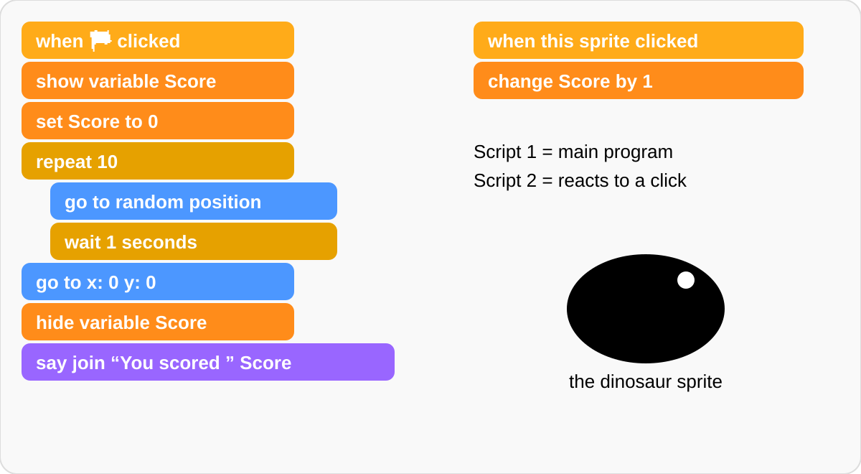
Now try this! Predict the program
1.3 Sub-routines
Flag clicked: Score is shown and set to 0
Dinosaur jumps to a random place, waits 1 second – 10 times
Each click on the dinosaur: Score +1
At the end the Score is hidden and the dinosaur says “You scored …”
ACTIVITY: with a partner, predict what happens
Notes:
ACTIVITY – Now try this. HOW IT IS DONE: students work with a partner, read the Scratch code, and predict what happens before running it. ANSWER: When the green flag is clicked the Score variable is shown and set to 0. The dinosaur jumps to a random position and waits 1 second, repeated 10 times. Each time the player clicks the dinosaur, the second script runs and adds 1 to Score. After 10 jumps the dinosaur goes to the centre, the Score is hidden and the dinosaur says 'You scored' followed by the final Score (0–10).

Slide 6

What is a sub-routine?
1.3 Sub-routines
A sub-routine is a section of code, separate from the main code, that performs a specific task
It can be used many times in one algorithm
Programmers use sub-routines to make code easier to understand and to reduce repetition
DEFINE = give it a name and write its instructions
CALL = use it by its name (as often as you need)
Notes:
A sub-routine is a named block of code that does one job. Defining = writing it once. Calling = using it. Use the playground analogy: calling someone's name makes them respond.

Slide 7
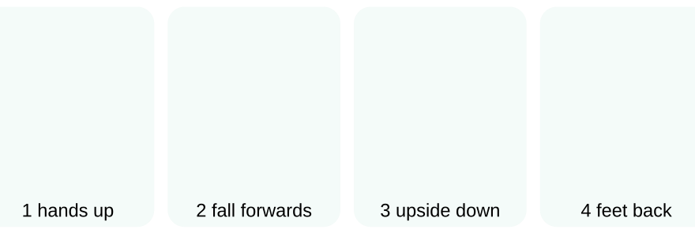
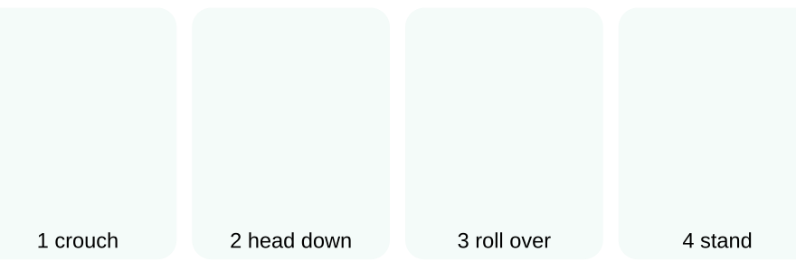
Using sub-routines within the same algorithm
1.3 Sub-routines
Handstand (4 steps)
Forward roll (3 steps)
Without sub-routines the instructions are very long, especially when moves repeat
With sub-routines each move is written once and called whenever it is needed
Fewer lines + easier to read + fewer mistakes
Notes:
A gymnast's routine contains moves we already know. Handstand = 4 steps, forward roll = 3 steps. Writing every step each time makes the instructions very long. Instead, define each move as a sub-routine and use it many times.

Slide 8
Unplugged Activity 1
You will need: a pen and paper
Task: Look at the 17-step gymnastics routine. Find the repeated moves, replace them with sub-routines and write the new algorithm.
NEW ALGORITHM
DEFINE handstand (4 steps)
DEFINE forward roll (3 steps)
1 CALL handstand
2 Step to the right
3 Step to the left
4 CALL forward roll
5 Do a star jump
6 CALL forward roll
7 CALL handstand
HOW TO DO IT
Steps 1–4 and 14–17 are the same: HANDSTAND
Steps 7–9 and 11–13 are the same: FORWARD ROLL
DEFINE both moves once, then CALL them
Keep the unique moves: step right, step left, star jump
Notes:
ACTIVITY 1 – how it is done: students circle repeated blocks in the 17-step list. The handstand block (steps 1-4 and 14-17) and the forward roll block (7-9 and 11-13) each appear twice. They write DEFINE sections once, then rewrite the routine using CALL. The 17 steps shrink to 7 lines plus the two definitions.

Slide 9
Questions and answers
1.3 Sub-routines
Q1 How many times is each sub-routine called in your new algorithm?
Answer: handstand is called 2 times and forward roll is called 2 times.
Q2 How would sub-routines help for 5 different moves, each called many times?
Each move is written only once, then called by name
The instructions are much shorter
Easier to read, and to fix: change the move in one place only
Notes:
Q1: handstand 2 times, forward roll 2 times. Q2: you would only write each move once, then call it. Total length shrinks a lot, fewer chances for mistakes, easier to edit.

Slide 10

Using sub-routines in different algorithms
1.3 Sub-routines
The same DEFINE can be called from different routines
Routine 1: forward roll ×2, handstand, turn around, star jump
Routine 2: star jump, handstand, clap, forward roll, handstand, forward roll, turn around
Define once – use in many algorithms
Notes:
The same sub-routine can be used in two or more different algorithms. Here Routine 1 and Routine 2 both call handstand and forward roll, but add their own extra moves (Routine 1: turn around, star jump; Routine 2: star jump, clap hands, turn around).

Slide 11
Unplugged Activity 2
You will need: a pen and paper
Task: Write algorithms for two different gymnastics routines that both use the handstand and forward roll sub-routines. You may create more sub-routines.
HOW TO DO IT
EXAMPLE ANSWER
Routine A: CALL handstand, CALL forward roll, star jump
Routine B: clap hands, CALL forward roll, CALL handstand, turn around, CALL handstand
Write DEFINE handstand and DEFINE forward roll
Write Routine A using CALL for both moves
Write Routine B with a different order and new moves
Optional: DEFINE star jump too
Notes:
ACTIVITY 2 – any correct answer is fine as long as both routines CALL the same two sub-routines and the DEFINE sections are written only once.

Slide 12
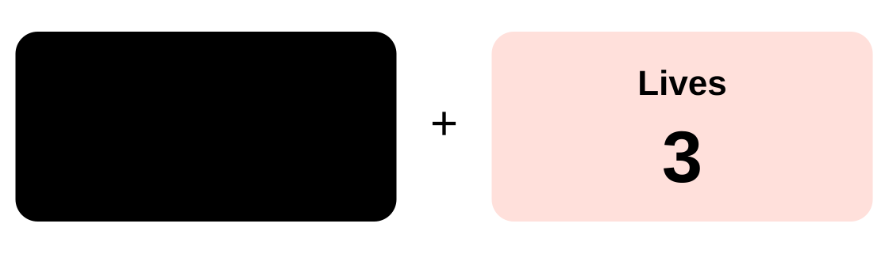
Using more than one variable
1.3 Sub-routines
A variable stores data that can change
Some programs need more than one variable
Score – counts the points scored
Lives – limits how many wrong answers are allowed
Starting values are set at the start: Set Score to 0, Set Lives to 3 (initialisation)
Notes:
A variable stores data that can change. A quiz game often needs two variables: Score to count points and Lives to limit wrong answers. More variables allow more complex programs.

Slide 13
Quiz algorithm: questions and answers
1.3 Sub-routines
3 Names of the variables?
Score and Lives
4 Starting data?
Score = 0, Lives = 3
5 Player enters 5?
Wrong: Lives becomes 2, Score stays 0
6 Player enters 7?
Correct: Score becomes 1, Lives stays 3
7 Start with 5 lives?
Change to: Set Lives to 5
8 2 points per answer?
Change to: change Score by 2
Notes:
Algorithm: when green flag clicked; Set Score to 0; Set Lives to 3; Say 'Welcome to this quiz!' for 2 seconds; Ask 'What is 3 + 4?' and wait; IF answer = 7 THEN change Score by 1 ELSE change Lives by -1.

Slide 14
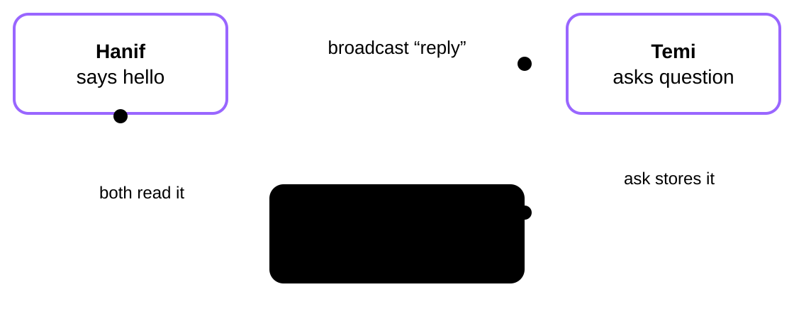
Unplugged Activity 3
Hanif and Temi are two sprites. Both use the answer variable. What does each sprite say if the user enters ‘basketball’?
HOW TO DO IT
Temi asks “What’s your favourite sport?” – the reply is stored in answer
Temi says “Amazing! I love basketball”, then broadcasts reply
Hanif receives reply and says “Oh no! I’m not very good at basketball”
With your partner: think of another question and how both sprites could use the answer
Notes:
ACTIVITY 3 – the 'ask' block stores the user's reply in the built-in answer variable. Both sprites can read the same variable. Temi: says 'Amazing! I love ' joined with answer. Hanif: after 'when I receive reply' says 'Oh no! I'm not very good at ' joined with answer. Extension ideas: 'What is your favourite food?', 'What is your favourite colour?'.

Slide 15
Developing programs with sub-routines
1.3 Sub-routines
Block-based languages let you drag and drop code blocks (e.g. Scratch)
broadcast = send a message to all sprites and scripts
when I receive = the script that runs when it hears that message
Like calling a sub-routine: the message is the name
broadcast reply → when I receive reply
Notes:
In Scratch the 'broadcast' and 'receive' blocks create sub-routine-like behaviour. Broadcast sends a message like a radio mast sending a signal; every script with a matching 'when I receive' block runs. Block-based languages such as Scratch are covered in Unit 4.

Slide 16
Summary
1.3 Sub-routines
Sub-routine: a named section of code that does one task
DEFINE: write the sub-routine once
CALL: use it as many times as needed, in any algorithm
Variables: several can be used together (Score, Lives); the same one can be shared by sprites
broadcast / receive: sprites send and respond to messages
Notes:
Quick recap – ask students to explain each point to a partner.

